Slide 1
Helicobacter pylori
Supervised by
Dr. Ibrahim Elsemman

Slide 2
Glycolysis & gluconeogenesis
Glycolysis is a catabolic process of glucose hydrolysis needed for energy and biosynthetic intermediates, whereas gluconeogenesis is a glucose production process important for maintaining blood glucose levels during starvation.
Glycolysis is the metabolic pathway that converts glucose C6H12O6, into pyruvate, CH3COCOO- and H+. The free energy released in this process is used to form the ATP and NADH.
Gluconeogenesis is a metabolic pathway that results in the generation of glucose from non-carbohydrate carbon substrates such as pyruvate, lactate, glycerol, glucogenic amino acids, and fatty acids.

Slide 3
Effect of Glycolysis & Gluconeogenesis on Helicobacter pylori
An enzyme of particular interest is the glucose-6-phosphate dehydrogenase (G6PD) in the metabolism of H. pylori. H. pylori is capable of metabolizing various different carbon sources, especially amino acids, and glucose [18,19], efficiently using them via the Entner-Doudoroff pathway (EDP) or the pentose phosphate pathway (PPP) [18][19][20][21][22] to synthesize triose phosphates and ribose phosphates with the generation of reducing power [23,24]. Although H. pylori can achieve the glycolytic breakdown of glucose, it has been reported that it lacks the glycolytic enzymes phosphofructokinase (PKF) and pyruvate kinase, affecting its ability to extract energy from hexoses.

Slide 4
Difference Between Glycolysis & Gluconeogenesis
Glycolysis | gluconeogenesis
Glycolysis is the set of reactions that convert glucose into two pyruvate molecules | Gluconeogenesis is the production of glucose from non-carbohydrate sources
The raw material is glucose | The raw material is lactate, amino acids like alanine and glycerol
Occurs in the cytoplasm of the cells | Occurs in both mitochondria & cytoplasm
A catabolic process | An anabolic process
Exergonic reaction | Endergonic reaction
Occurs through ten reactions | Two essentially irreversible reactions in the glycolytic pathway are bypassed by four new reactions

Slide 5
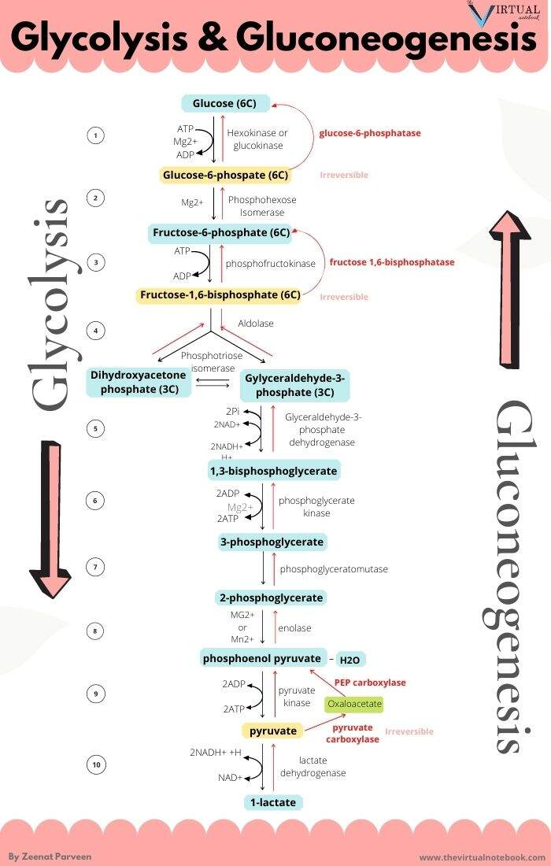

Slide 6
Citric acid cycle
The citric acid cycle (CAC)—also known as the Krebs cycle or the TCA cycle (tricarboxylic acid cycle),The citric acid cycle is a key metabolic pathway that connects carbohydrate, fat, and protein metabolism. The reactions of the cycle are done with the aid of 8 enzymes that completely oxidize acetate (a two carbon molecule), inside the shape of acetyl-CoA, into molecules every of carbon dioxide and water. via catabolism of sugars, fat, and proteins, the 2-carbon organic product acetyl-CoA is produced which enters the citric acid cycle. The reactions of the cycle also convert three equivalents of nicotinamide adenine dinucleotide (NAD+) into 3 equivalents of decreased NAD+ (NADH), one equivalent of flavin adenine dinucleotide (FAD) into one equal of FADH2, and one equivalent each of guanosine diphosphate (GDP) and inorganic phosphate (Pi) into one equal of guanosine triphosphate (GTP). The NADH and FADH2 generated by means of the citric acid cycle are, in turn, used by the oxidative phosphorylation pathway to generate power-rich ATP.
One of the primary sources of acetyl-CoA is from the breakdown of sugars by glycolysis which yield pyruvate that in turn is decarboxylated by the pyruvate dehydrogenase complex generating acetyl-CoA according to the following reaction scheme:
CH3C(=O)C(=O)O−pyruvate + HSCoA + NAD+ → CH3C(=O)SCoAacetyl-CoA + NADH + CO2

Slide 7
Steps :
Step 1. In the first step of the citric acid cycle, acetyl Co Astart text, C, o, A, end text joins with a four-carbon molecule, oxaloacetate, releasing the Co Astart text, C, o, A, end text group and forming a six-carbon molecule called citrate.
Step 2. In the second step, citrate is converted into its isomer, isocitrate. This is actually a two-step process, involving first the removal and then the addition of a water molecule, which is why the citric acid cycle is sometimes described as having nine steps—rather than the eight listed here^33cubed.
Step 3. In the third step, isocitrate is oxidized and releases a molecule of carbon dioxide, leaving behind a five-carbon molecule—α-ketoglutarate. During this step, \text{NAD}^+NAD+start text, N, A, D, end text, start superscript, plus, end superscript is reduced to form \text{NADH}NADHstart text, N, A, D, H, end text. The enzyme catalyzing this step, isocitrate dehydrogenase, is important in regulating the speed of the citric acid cycle.

Slide 8
Step 4. The fourth step is similar to the third. In this case, it’s α-ketoglutarate that’s oxidized, reducing \text{NAD}^+NAD+start text, N, A, D, end text, start superscript, plus, end superscript to \text{NADH}NADHstart text, N, A, D, H, end text and releasing a molecule of carbon dioxide in the process. The remaining four-carbon molecule picks up Coenzyme A, forming the unstable compound succinyl \text{CoA}CoAstart text, C, o, A, end text. The enzyme catalyzing this step, α-ketoglutarate dehydrogenase, is also important in regulation of the citric acid cycle.
Step 5. In step five, the \text{CoA}CoAstart text, C, o, A, end text of succinyl \text{CoA}CoAstart text, C, o, A, end text is replaced by a phosphate group, which is then transferred to \text{ADP}ADPstart text, A, D, P, end text to make \text{ATP}ATPstart text, A, T, P, end text. In some cells, \text{GDP}GDPstart text, G, D, P, end text—guanosine diphosphate—is used instead of \text{ADP}ADPstart text, A, D, P, end text, forming \text{GTP}GTPstart text, G, T, P, end text—guanosine triphosphate—as a product. The four-carbon molecule produced in this step is called succinate.

Slide 9
Step 6. In step six, succinate is oxidized, forming another four-carbon molecule called fumarate. In this reaction, two hydrogen atoms—with their electrons—are transferred to \text{FAD}FADstart text, F, A, D, end text, producing \text{FADH}_2FADH2 start text, F, A, D, H, end text, start subscript, 2, end subscript. The enzyme that carries out this step is embedded in the inner membrane of the mitochondrion, so \text{FADH}_2FADH2 start text, F, A, D, H, end text, start subscript, 2, end subscript can transfer its electrons directly into the electron transport chain.
Step 7. In step seven, water is added to the four-carbon molecule fumarate, converting it into another four-carbon molecule called malate.
Step 8. In the last step of the citric acid cycle, oxaloacetate—the starting four-carbon compound—is regenerated by oxidation of malate. Another molecule of \text{NAD}^+NAD+start text, N, A, D, end text, start superscript, plus, end superscript is reduced to \text{NADH}NADHstart text, N, A, D, H, end text in the process.

Slide 10
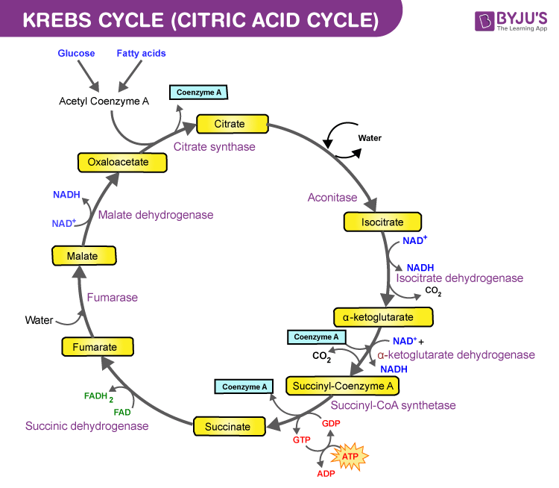

Slide 11
Products of the citric acid cycle :
In a single turn of the cycle,
two carbons enter from acetyl (CoA)CoAstart text, C, o, A, end text, and two molecules of carbon dioxide are released;
three molecules of NADHstart text, N, A, D, H, end text and one molecule of 2FADH2 start text, F, A, D, H, end text, start subscript, 2, end subscript are generated; and
one molecule of ATPstart text, A, T, P, end text or GTPstart text, G, T, P, end text is produced.

Slide 12
The pentose phosphate pathway (PPP)
The pentose phosphate pathway (PPP) branches from glucose 6-phosphate (G6P), produces NADPH and ribose 5-phosphate (R5P), and shunts carbons back to the glycolytic or gluconeogenic pathway. The PPP has been demonstrated to be a major regulator for cellular reduction-oxidation (redox) homeostasis and biosynthesis. Enzymes in the PPP play important roles in many human diseases.
The pentose phosphate pathway (PPP), also known as the pentose phosphate shunt, is an important part of glucose metabolism. The PPP branches after the first step of glycolysis and consumes the intermediate glucose 6-phosphate (G6P) to generate fructose 6-phosphate (F6P) and glyceraldehyde 3-phosphate (G3P) through the oxidative and non-oxidative branches of the PPP. Unlike glycolysis and glucose aerobic oxidation, the PPP does not provide adenosine 5′-triphosphate (ATP) to meet the energy demands of cells. Instead, it supplies NADPH and ribose 5-phosphate (R5P). These two metabolites are vital for the survival and proliferation of cells. R5P is a building block for nucleic acid synthesis. NADPH is the reducing power required for the synthesis of fatty acids, sterols, nucleotides and non-essential amino acids (1, 2). Moreover, NADPH-derived conversion of oxidized glutathione (GSSG) to reduced glutathione (GSH) via glutathione reductase is important for cellular antioxidant defenses. Interestingly, NADPH also serves as the substrate of NADPH oxidases (NOXs) which produce reactive oxygen species (ROS)

Slide 13
The Role of the PPP in Type 2 Diabetes Mellitus (T2DM)
T2DM is a chronic metabolic disease featured by persistently abnormal hyperglycemia, which can cause serious chronic damage to kidneys, eyes, and nerves. Deregulated insulin secretion and progressive insulin resistance are two main characteristics of T2DM (6). Over the past few decades, studies on the pathogenesis of T2DM have revealed a close relationship between the PPP, obesity-related insulin resistance and T2DM.

Slide 14
The Role of the PPP in Cancer
The PPP is critical for cancer prevention and treatment because NADPH and R5P play important roles in regulating DNA damage response, metabolism, and proliferation in cancer cells. Various enzymes in the PPP have been shown to be potential targets in cancer therapy. These proteins not only function as metabolic enzymes, but also participate in the regulation of other cellular activities.

Slide 15
Evidence for a pentose phosphate pathway in Helicobacter pylori
Evidence for the presence of enzymes of the pentose phosphate pathway in Helicobacter pylori was obtained using 31P nuclear magnetic resonance spectroscopy. Activities of enzymes that are part of the oxidative and non-oxidative phases of the pathway were observed directly in the incubations of bacterial lysates with pathway intermediates. Generation of NADPH and 6-phosphogluconate from NADP+ and glucose 6-phosphate indicated the presence of glucose 6-phosphate dehydrogenase and 6-phosphogluconolactonase. Reduction of NADP+ with the production of ribulose 5-phosphate from 6-phosphogluconate revealed 6-phosphogluconate dehydrogenase activity. Phosphopentose isomerase and transketolase activities were observed in incubations containing ribulose 5-phosphate and xylulose 5-phosphate, respectively. The formation of erythrose 4-phosphate from xylulose 5-phosphate and ribose 5-phosphate suggested the presence of transaldolase. The activities of this enzyme and triosephosphate isomerase were observed directly in the incubations of bacterial lysates with dihydroxyacetone phosphate and sedoheptulose 7-phosphate. Glucose-6-phosphate isomerase activity was measured in incubations with fructose 6-phosphate. The presence of these enzymes in H. pylori suggested the existence of a pentose phosphate pathway in the bacterium, possibly as a mechanism to provide NADPH for reductive biosynthesis and ribose 5-phosphate for the synthesis of nucleic acids

Slide 16
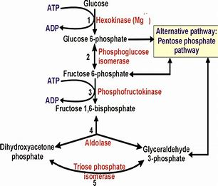

Slide 17
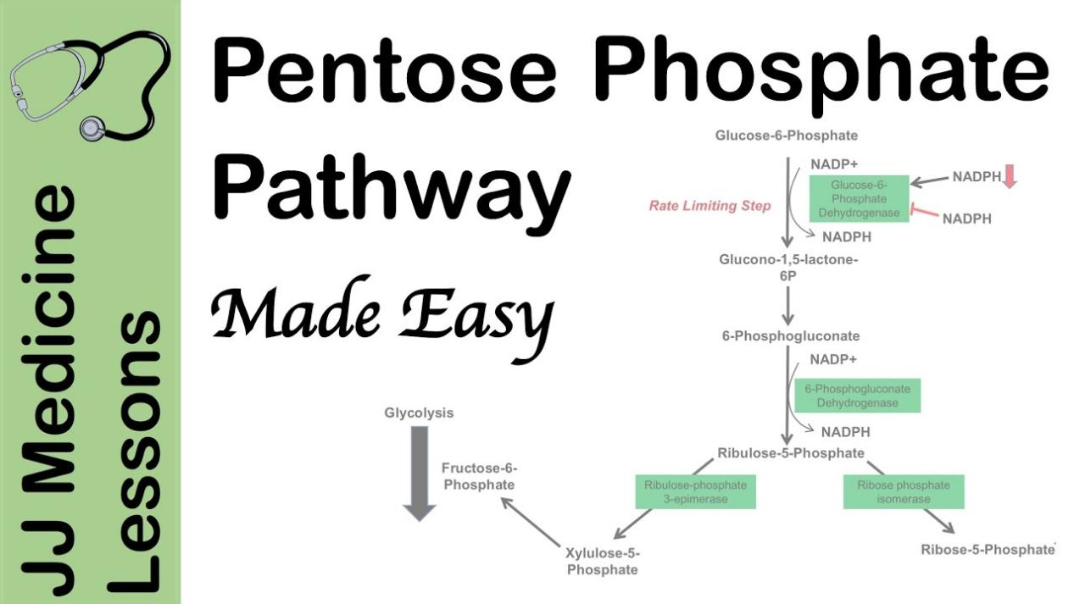

Slide 18
Glycine, serine and threonine catabolic pathway
Serum resistance is a poorly understood but common trait of some difficult-to-treat pathogenic strains of bacteria. that glycine, serine and threonine catabolic pathway is down-regulated in serum-resistant Escherichia coli, whereas exogenous glycine reverts the serum resistance and effectively potentiates serum to eliminate clinically-relevant bacterial pathogens in vitro and in vivo. We find that exogenous glycine increases the formation of membrane attack complex on bacterial membrane through two previously unrecognized regulations: 1) glycine negatively and positively regulates metabolic flux to purine biosynthesis and Krebs cycle, respectively. 2) α-Ketoglutarate inhibits adenosine triphosphate synthase, which in together promote the formation of cAMP/CRP regulon to increase the expression of complement-binding proteins HtrE, NfrA, and YhcD. The results could lead to effective strategies for managing the infection with serum-resistant bacteria, an especially valuable approach for treating individuals with weak acquired immunity but a normal complement system

Slide 19
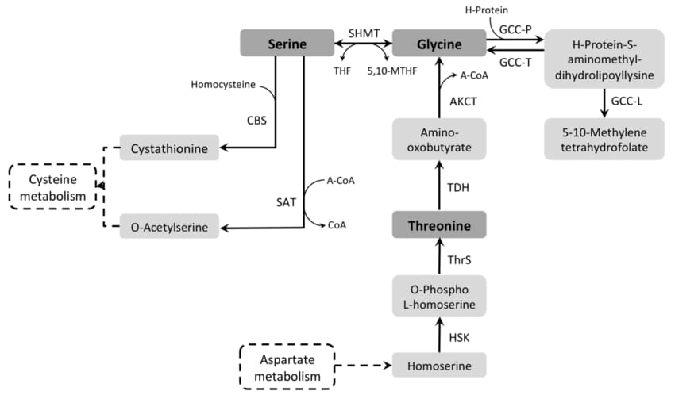

Slide 20
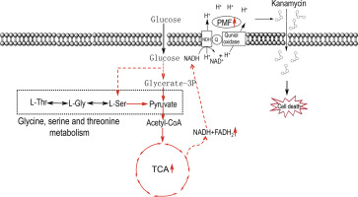

Slide 21
Glycine increases the susceptibility of E. coli to serum. a Percent survival of E. coli K12 incubated with 100 μL serum in the presence or absence of 100 mM glycine, serine, or threonine (n = 3). b Synergetic effects of 100 μL serum and glycine on viability of E. coli K12 were measured in a glycine dose-dependent manner (0–100 mM) (n = 3). c Percent survival of E. coli K12 incubated with 100 mM glycine plus serum (0–100 μL) or without glycine (n = 3). d, e Percent survival of E. coli K12 (d) and Y17 (e) in the presence of 100 mM glycine or/and 100 μL serum for the indicated length of time (n = 3). f Percent survival of E. coli K12 in the presence of 100 mM glycine or/and 100 μL serum or anti-C3 absorbed serum for 2 h (n = 3). Results are displayed as mean ± SEM (a–f), and significant differences are identified (*p < 0.05, **p < 0.01) as determined by two-tailed Student’s t test (a–c, f)

Slide 22
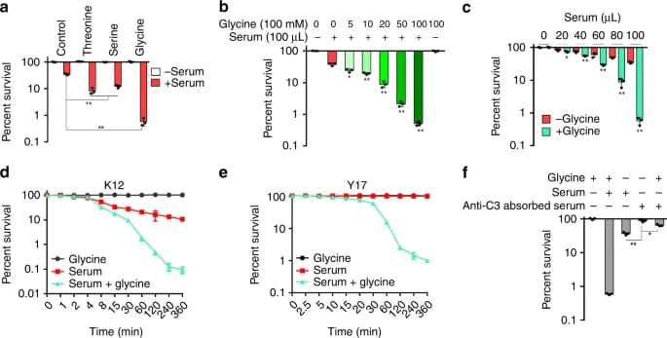

Slide 23
Cysteine and methionine metabolism
What is methionine and cysteine?
Methionine (Met) is an essential sulfur amino acid (AA) limiting growth and is the precursor of cysteine (Cys), the rate-limiting factor in the synthesis of glutathione, and the main intracellular non-enzymatic antioxidant.

Slide 24
Description
Cysteine and methionine are sulfur-containing amino acids. Cysteine is synthesized from serine through different pathways in different organism groups. In bacteria and plants, cysteine is converted from serine (via acetylserine) by transfer of hydrogen sulfide [MD:M00021]. In animals, methionine-derived homocysteine is used as sulfur source and its condensation product with serine (cystathionine) is converted to cysteine [MD:M00338]. Cysteine is metabolized to pyruvate in multiple routes. Methionine is an essential amino acid, which animals cannot synthesize. In bacteria and plants, methionine is synthesized from aspartate [MD:M00017]. S-Adenosylmethionine (SAM), synthesized from methionine and ATP, is a methyl group donor in many important transfer reactions including DNA methylation for regulation of gene expression. SAM may also be used to regenerate methionine in the methionine salvage pathway [MD:M00034].

Slide 25
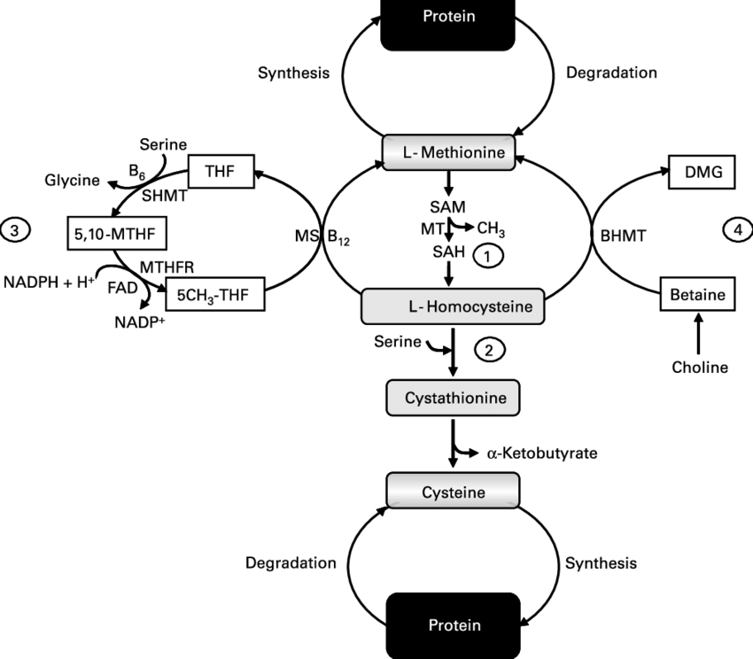
Overview of Cysteine and methionine metabolism

Slide 26
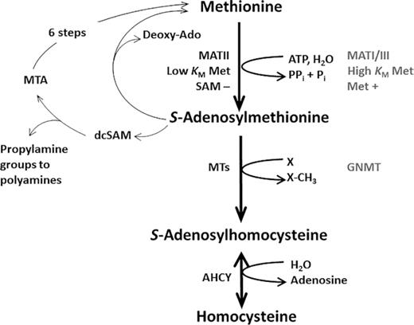
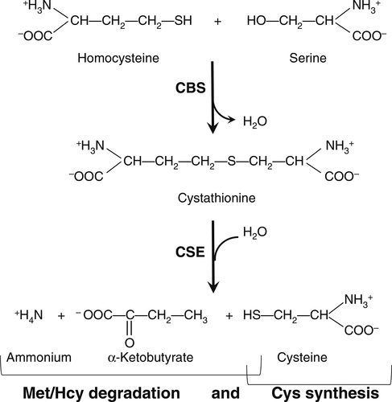
Transsulfuration pathway for homocysteine degradation and cysteine synthesis

Slide 27
The catabolism of Cys is essential for conversion of the sulfur to its normal end products (sulfate, taurine) that can be excreted in the urine.
Although the transsulfuration pathway allows for biosynthesis of Cys from Met sulfur and serine, this reaction is less critical because Cys, as with other amino acids, can be obtained preformed in the diet.
The conclusion that the major role of the transsulfuration pathway in animals is Met/Hcy degradation rather than cysteine biosynthesis seems consistent with its robust regulation by S-adenosylmethionine to minimize Met/Hcy degradation when Met availability is low and facilitate it when Met levels are high. Cys synthesis as a product of the transsulfuration pathway can be viewed as a part of Met/Hcy degradation, with Cys being the vehicle for Met/Hcy sulfur conversion to end products that can be excreted in the urine.

Slide 28
Role of Helicobacter pylori in Cysteine and methionine metabolism
Helicobacter pylori lacks an enzyme catalyzing homocysteine-to-methionine conversion, rendering the AMC incomplete and thus making any metabolic role of H. pylori LuxS (LuxS(Hp)) unclear.
Methionine is a unique sulfur-containing amino acid which plays an important role in biological protein synthesis and various cellular processes.
Methionine is an aliphatic, sulfur-containing, essential amino acid, and a precursor of succinyl-CoA, homocysteine, cysteine, creatine, and carnitine. Recent research has demonstrated that methionine can regulate metabolic processes, the innate immune system, and digestive functioning in mammals. It also intervenes in lipid metabolism, activation of endogenous antioxidant enzymes such as methionine sulfoxide reductase A, and the biosynthesis of glutathione to counteract oxidative stress. In addition, methionine restriction prevents altered methionine/transmethylation metabolism, thereby decreasing DNA damage and carcinogenic processes and possibly preventing arterial, neuropsychiatric, and neurodegenerative diseases. This review focuses on the role of methionine in metabolism, oxidative stress, and related diseases.

Slide 29
Lysine biosynthesis
What is lysine biosynthesis?
The human body cannot synthesize lysine. It is essential in humans and must therefore be obtained from the diet. In organisms that synthesise lysine, two main biosynthetic pathways exist, the diaminopimelate and α-aminoadipate pathways, which employ distinct enzymes and substrates and are found in diverse organisms.

Slide 30
The importance of Lysine
Lysine, or L-lysine, is an essential amino acid, meaning it is necessary for human health, but the body cannot make it. You have to get lysine from food or supplements. Amino acids like lysine are the building blocks of protein. Lysine is important for proper growth, and it plays an essential role in the production of carnitine, a nutrient responsible for converting fatty acids into energy and helping lower cholesterol. Lysine appears to help the body absorb calcium, and it plays an important role in the formation of collagen, a substance important for bones and connective tissues including skin, tendons, and cartilage.

Slide 31
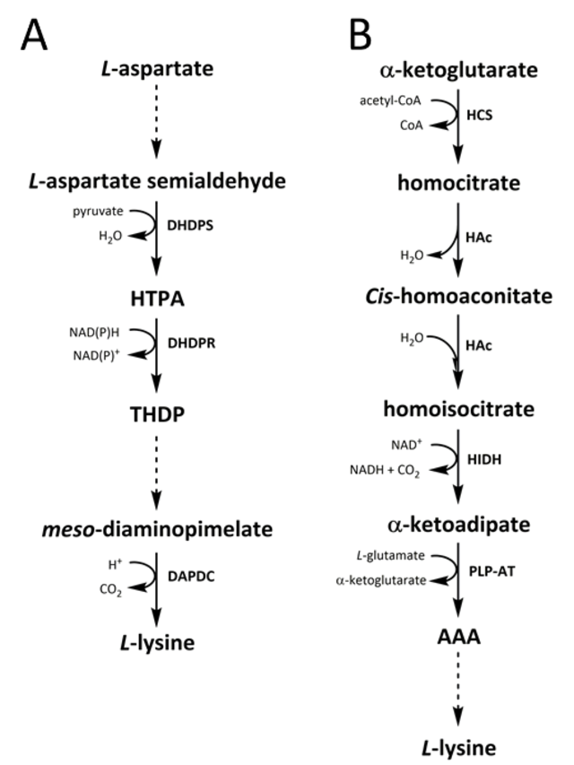

Slide 32
Lysine degradation
The degradation of L-lysine happens in liver and it is consisted of seven reactions. L-Lysine is imported into liver through low affinity cationic amino acid transporter 2 (cationic amino acid transporter 2/SLC7A2). Afterwards, L-lysine is imported into mitochondria via mitochondrial ornithine transporter 2. L-Lysine can also be obtained from biotin metabolism. L-Lysine and oxoglutaric acid will be combined to form saccharopine by facilitation of mitochondrial alpha-aminoadipic semialdehyde synthase, and then, mitochondrial alpha-aminoadipic semialdehyde synthase will further breaks saccharopine down to allysine and glutamic acid. Allysine will be degraded to form aminoadipic acid through alpha-aminoadipic semialdehyde dehydrogenase. Oxoadipic acid is formed from catalyzation of mitochondrial kynurenine/alpha-aminoadipate aminotransferase on aminoadipic acid. Oxoadipic acid will be further catalyzed to form glutaryl-CoA, and glutaryl-CoA converts to crotonoyl-CoA, and crotonoyl-CoA transformed to 3-hydroxybutyryl-CoA. 3-Hydroxybutyryl-CoA will form Acetyl-CoA as the final product through the intermediate compound: acetoacetyl-CoA. Acetyl-CoA will undergo citric acid cycle metabolism. Carnitine is another key byproduct of lysine metabolism (not shown in this pathway).

Slide 33
Arginine biosynthetic pathway
Arginine (Arg) is synthesised from glutamine, glutamate, and proline via the intestinal-renal axis in humans and most other mammals (including pigs, sheep and rats). Arg degradation occurs via multiple pathways that are initiated by arginase, nitric-oxide synthase, Arg:glycine amidinotransferase, and Arg decarboxylase. These pathways produce nitric oxide, polyamines, proline, glutamate, creatine, and agmatine with each having enormous biological importance. Arg is also required for the detoxification of ammonia, which is an extremely toxic substance for the central nervous system. There is compelling evidence that Arg regulates interorgan metabolism of energy substrates and the function of multiple organs. The results of both experimental and clinical studies indicate that Arg is a nutritionally essential amino acid (AA) for spermatogenesis, embryonic survival, fetal and neonatal growth, as well as maintenance of vascular tone and hemodynamics. Moreover, a growing body of evidence clearly indicates that dietary supplementation or intravenous administration of Arg is beneficial in improving reproductive, cardiovascular, pulmonary, renal, gastrointestinal, liver and immune functions, as well as facilitating wound healing, enhancing insulin sensitivity, and maintaining tissue integrity. Additionally, Arg or l-citrulline may provide novel and effective therapies for obesity, diabetes, and the metabolic syndrome. The effect of Arg in treating many developmental and health problems is unique among AAs, and offers great promise for improved health and wellbeing of humans and animals.

Slide 34
In the arginine biosynthetic pathway of the vast majority of prokaryotes, the formation of ornithine is catalyzed by an enzyme transferring the acetyl group of N-α-acetylornithine to glutamate (ornithine acetyltransferase [OATase]) (argJ encoded).
arginine is produced in several ways. It can be synthesized from the amino acid citrulline through the breakdown of body proteins, or it can be obtained through dietary protein intake ( 2 ). It's concentrated in certain protein-rich foods, including meat, poultry, dairy, nuts, soy products, and fish.
Arginine can be synthesized from enteral proline in healthy adult humans.
Although it is often stated in biochemistry and nutrition textbooks that arginine is formed in the mammalian liver, there is no net synthesis of Arg via the hepatic urea cycle because the liver contains an exceedingly high arginase activity to hydrolyze Arg into urea plus ornithine.
Arginine is synthesized from proline, not glutamate, in enterally fed human preterm neonates.

Slide 35
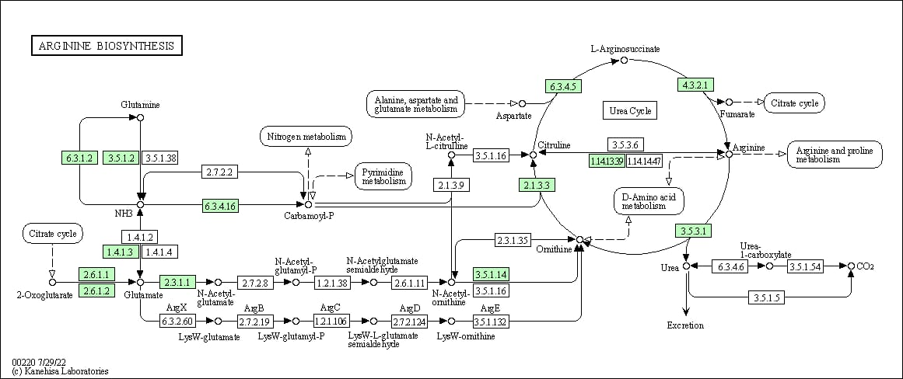

Slide 36
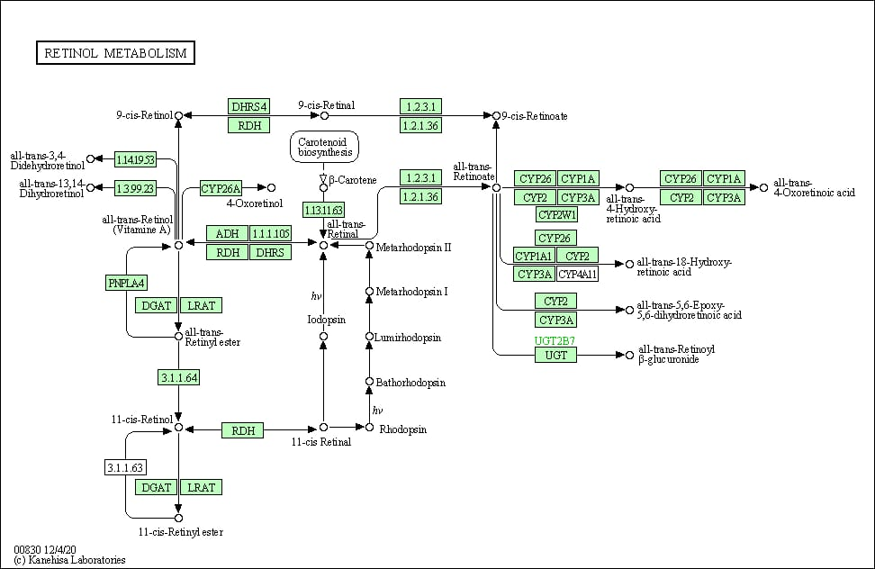

Slide 37
Tryptophan metabolism
Introduction:
Tryptophan (Trp) metabolism is associated with aging and produces metabolites that control inflammation, regulate energy homeostasis and modulate behavior (8). We discuss how activation of Trp metabolism could be involved in the control of inflammation and how this can alter the Trp metabolite milieu.

Slide 38
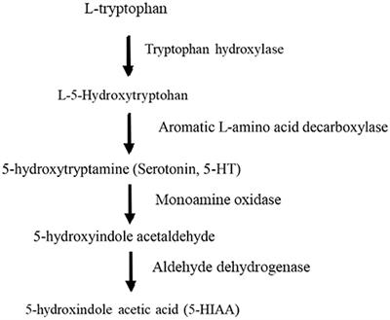

Slide 39
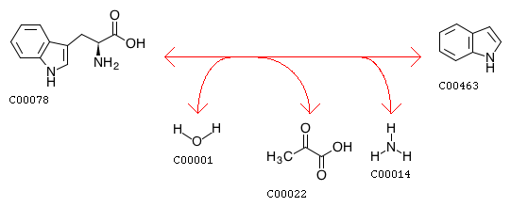
Helicobacter pylori and serum kynurenine-tryptophan ratio in patients with colorectal cancer
A significantly high kynurenine/tryptophan suggested that H. pylori may support the immune tolerance leading to cancer development, even without an apparent upper gastrointestinal tract disease

Slide 40
Thanks,,

